Slide 1

String and String Manipulation
SCJ1013 Programming Technique II
SEM2 2013/2014
Week 4
Source from Tony Gaddis, Barret Krupnow, Starting out with C++, 6th edition update. 2010. Pearson

Slide 2
10.1
Character Testing

Slide 3
Character Case Conversion
The C++ library provides several functions for testing characters.
To use these functions, you must include the cctype header file.

Slide 4
Character Testing
require cctype header file
FUNCTION | MEANING
isalpha | true if arg. is a letter, false otherwise
isalnum | true if arg. is a letter or digit, false otherwise
isdigit | true if arg. is a digit 0-9, false otherwise
islower | true if arg. is lowercase letter, false otherwise
isprint | true if arg. is a printable character, false otherwise
ispunct | true if arg. is a punctuation character, false otherwise
isupper | true if arg. is an uppercase letter, false otherwise
isspace | true if arg. is a whitespace character, false otherwise

Slide 5
Characters testing – Example from Program 10-1
#include <iostream>
#include <cctype>
using namespace std;
int main()
{ char input;
cout<<"Enter any character: ";
cin.get(input);
if (isalpha(input)){
cout.put(input);
cout<<"It is an alphabet";}
if ( isdigit(input))
cout<<"It is a digit";
if (islower(input))
cout<<"The letter entered is lowercase";
if (isupper(input))
cout<<"The letter entered is uppercase";
return 0;}

Slide 6
Exercise Week04_01
Write a program with if statements that will display the word “digit” if the variable ch contains numeric data, or display the word “letter” if the variable ch contains alphabet data. Otherwise, it should display “special character”

Slide 7
10.2
Character Case Conversion

Slide 8
Character Case Conversion
Require cctype header file
Functions:
  toupper: if char argument is lowercase letter, return uppercase equivalent; otherwise, return input unchanged
  char ch1 = 'H';
  char ch2 = 'e';
  char ch3 = '!';
  cout << toupper(ch1); // displays 'H'
  cout << toupper(ch2); // displays 'E'
  cout << toupper(ch3); // displays '!'

Slide 9
Character Case Conversion
Functions:
  tolower: if char argument is uppercase letter, return lowercase equivalent; otherwise, return input unchanged
  char ch1 = 'H';
  char ch2 = 'e';
  char ch3 = '!';
  cout << tolower(ch1); // displays 'h'
  cout << tolower(ch2); // displays 'e'
  cout << tolower(ch3); // displays '!'

Slide 10
Character Case Conversion – example
#include <iostream>
#include <cctype>
using namespace std;
int main()
{
char input[15];
cout<<"Enter a name ";
cin>>input;
for(int i=0;input[i] != '\0';i++)
input[i]= toupper(input[i]);
cout<<"The name in upper case is:" << input;
return 0;
}

Slide 11
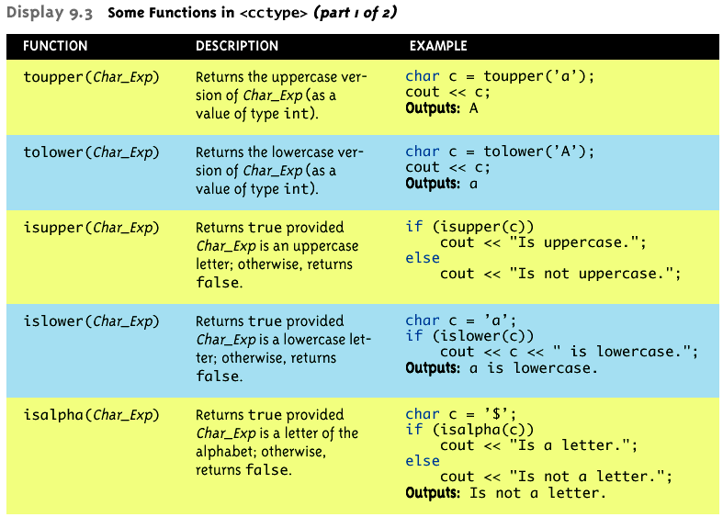
Character-Manipulating Functions

Slide 12
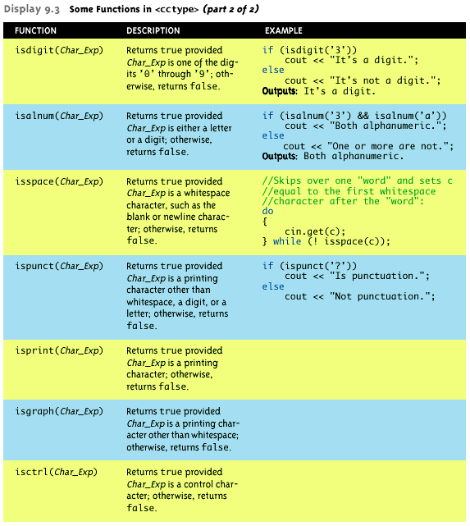

Slide 13
Exercise Week04_02
Write a program to toggle the contents of a string character from lower to upper case or vice verse.

Slide 14
Strings in C & C++

Slide 15
Strings in C & C++
Two ways:
  C-strings
  C++ string Class

Slide 16
10.3
Review of the Internal Storage of C-Strings

Slide 17
Review of the Internal Storage of C-Strings
C-string: sequence of characters stored in adjacent memory locations and terminated by NULL character
String literal (string constant): sequence of characters enclosed in double quotes " " : "Hi there!"
H
i
t
h
e
r
e
!
\0

Slide 18
C-Strings Manipulation Functions
The C++ library has numerous functions for handling C-strings.
Requires cstring header file be included.

Slide 19
Review of the Internal
Storage of C-Strings
Array of chars can be used to define storage for string:
const int SIZE = 20;
char city[SIZE];
Leave room for NULL at end
Can enter a value using cin or >>
  Input is whitespace-terminated
  No check to see if enough space
For input containing whitespace, and to control amount of input, use cin.getline()

Slide 20
C-String Input - Example
  char a[80], b[80];
  cout << “Enter input: “;
  cin >> a >> b;
  cout << a << b << “END OF OUTPUT\n”;
  Running example:
Enter input: Do be do to you!
DobeEND OF OUTPUT
  Note: Underlined portion typed at keyboard
C-string a receives: “do”
C-string b receives: “be”

Slide 21
C-String Line Input
Can receive entire line into c-string
Use getline(), a predefined member function:
char a[80];
cout << “Enter input: “;
cin.getline(a, 80);
cout << a << “END OF OUTPUT\n”;
Running example:
Enter input: Do be do to you!
Do be do to you!END OF INPUT

Slide 22
C-String Line Input
Can explicitly tell length to receive:
char shortString[5];
cout << “Enter input: “;
cin.getline(shortString, 5);
cout << shortString << “END OF OUTPUT\n”;
Results:
Enter input: dobedowap
dobeEND OF OUTPUT
Forces FOUR characters only be read
    Recall need for null character!

Slide 23
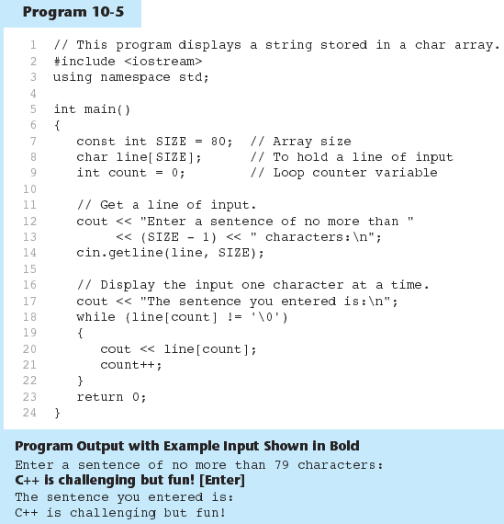
Example of C-String Line Input

Slide 24
C-String – Declaration & Initialize
You can use a literal string to initialize a c-string when you declare it:
char harry[100] = "Harry";
OK to omit the length:
char ron[] = "Ron";
equivalent to:
char ron[4] = "Ron";
The following is an error:
char ron[3] = "Ron";

Slide 25
10.4
Library Functions for Working with C-Strings

Slide 26
Library Functions for Working with C-Strings
Require the cstring header file
Functions take one or more C-strings as arguments. Can use:
  C-string name
  pointer to C-string
  literal string

Slide 27
Working with C-Strings
Functions:
  strlen(str): returns length of C-string str
    char city[SIZE] = "Missoula";
    cout << strlen(city); // prints 8
  strcat(str1, str2): appends str2 to the end of str1
    char location[SIZE] = "Missoula, ";
    char state[3] = "MT";
    strcat(location, state);
    // location now has "Missoula, MT"

Slide 28
= and == with C-strings
C-strings not like other variables
  Cannot assign or compare:
  char aString[10];
  aString = “Hello”; // ILLEGAL!
    Can ONLY use ‘=‘ at declaration of c-string!
Must use library function for assignment:
strcpy(aString, “Hello”);
  Built-in function (in <cstring>)
  Sets value of aString equal to “Hello”

Slide 29
Working with C-Strings
Functions:
  strcpy(str1, str2): copies str2 to str1
  const int SIZE = 20;
  char fname[SIZE] = "Maureen", name[SIZE];
  strcpy(name, fname);
  Note: strcat and strcpy perform no bounds checking to determine if there is enough space in receiving character array to hold the string it is being assigned.

Slide 30
C-string Inside a C-string
Function:
  strstr(str1, str2): finds the first occurrence of str2 in str1. Returns a pointer to match, or NULL if no match.
    char river[] = "Wabash";
    char word[] = "aba";
    cout << strstr(state, word);
    // displays "abash"

Slide 31
Comparing C-strings
Also cannot use operator ==
char aString[10] = “Hello”;
char anotherString[10] = “Goodbye”;
  aString == anotherString; // NOT allowed!
Must use library function again:
if (strcmp(aString, anotherString))
cout << “Strings NOT same.”;
else
cout << “Strings are same.”;

Slide 32
Example
Working with C-Strings - example
#include <iostream>
#include <cstring>
using namespace std;
int main()
{ char reply;
char garment[]="overcoat";
cout<<"Is it raining outside? Answer y/n\n";
cin>>reply;
if(reply=='y')
strcpy(garment,"raincoat");
cout<<"before you go out today take your "<<garment;
return 0;
}

Slide 33
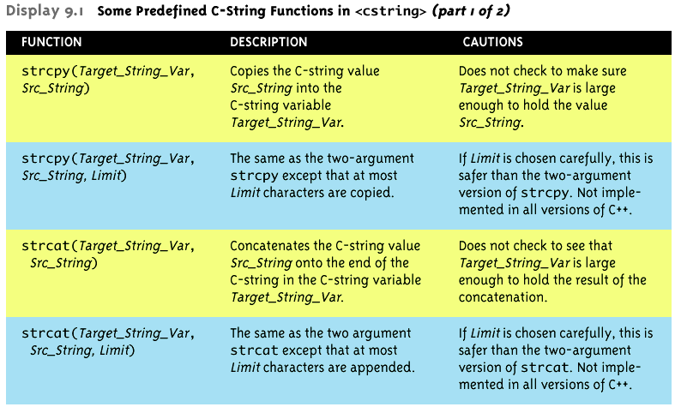
strncpy
strncat

Slide 34
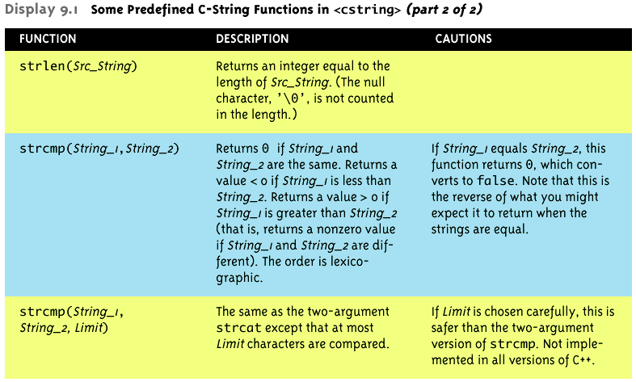
strncmp (String_1, String_2, Limit)

Slide 35
Exercise Week04_03
What will the following program segment display?
    char cat[] = “Fido”;
    cout<<strlen(cat)<<endl;
What will the following program segment display?
    char string1[16]="Have a ";
    char string2[9] = "nice day";
    strcat(string1, string2);
    cout<<string1<<endl;
    cout<<string2<<endl;

Slide 36
Exercise Week04_04
Do Lab 6, Exercise 2, Question 2, 3, 4 (pg. 95 - 96)

Slide 37
10.5
String/Numeric Conversion Functions

Slide 38
String/Numeric Conversion Functions
These functions convert between string and numeric forms of numbers
Need to include cstdlib header file

Slide 39
String/Numeric Conversion Functions
require cstdlib header file
FUNCTION | PARAMETER | ACTION
atoi | C-string | converts C-string to an int value, returns the value
atol | C-string | converts C-string to a long value, returns the value
atof | C-string | converts C-string to a double value, returns the value
itoa | int,C-string, int | converts 1st int parameter to a C-string, stores it in 2nd parameter. 3rd parameter is base of converted value

Slide 40
atoi, atol and atof
atoi converts alphanumeric to int
atol converts alphanumeric to long
atof converts a numeric string to a double
if C-string being converted contains non-digits, results are undefined
  function may return result of conversion up to first non-digit
  function may return 0

Slide 41
atoi, atol and atof
Examples:
  int number;
  long lnumber;
  double dnumber;
  number = atoi("57");
  lnumber = atol("50000");
  dnumber = atof(“590.55”);

Slide 42
itoa
itoa converts an int to an alphanumeric string
Allows user to specify the base of conversion
itoa(int num, char numStr, int base)
  num : number to convert
  numStr: array to hold resulting string
  base: base of conversion
Example: To convert the number 1200 to a hexadecimal string
char numStr[10];
itoa(1200, numStr, 16);

Slide 43
Exercise Week04_05
Do Lab 6, Exercise 3, Question 2 (pg. 97)
Do Lab 6, Exercise 3, Question 3 (pg. 97) → You must use an array of characters.

Slide 44
10.6
Writing Your Own C-String Handling Functions

Slide 45
Writing Your Own C-String Handling Functions
Designing C-String Handling Functions
  can pass arrays or pointers to char arrays
  Can perform bounds checking to ensure enough space for results
  Can anticipate unexpected user input

Slide 46
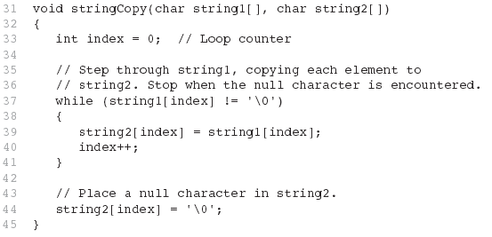
From Program 10-9

Slide 47
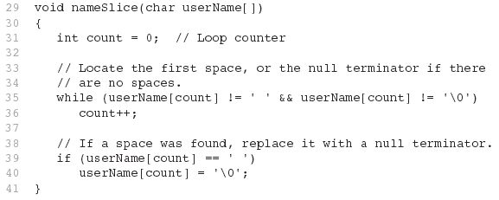
From Program 10-10

Slide 48
10.7
The C++ string Class

Slide 49
The C++ string Class
The string class offers several advantages over C-style strings:
  large body of member functions
  overloaded operators to simplify expressions
Special data type supports working with strings
#include <string>

Slide 50
The C++ string Class
Can define string variables in programs:
  string firstName, lastName;
Can receive values with assignment operator:
  firstName = "George";
  lastName = "Washington";
Can be displayed via cout
  cout << firstName << " " << lastName;

Slide 51
The C++ string Class
Objects of type string can be declared and initialized in several ways:
    string s1;
    string s2 = "New York";
    string s3('*‘, 60);
    string s4 = s3;
    string s5 = ‘N’ //illegal
    String s6 =78 // illegal
If the string is not initialized, it represents the empty string.

Slide 52
Other Definitions of C++ strings
Definition | Meaning
string name; | defines an empty string object
string myname("Chris"); | defines a string and initializes it
string yourname(myname); | defines a string and initializes it
string aname(myname, 3); | defines a string and initializes it with first 3 characters of myname
string verb(myname,3,2); | defines a string and initializes it with 2 characters from myname starting at position 3
string noname('A', 5); | defines string and initializes it to 5 'A's

Slide 53
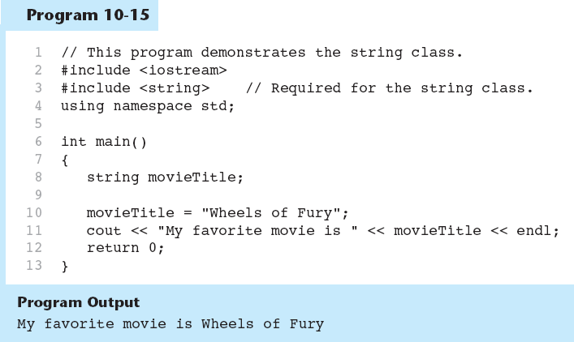
String output - example

Slide 54
Input into a string Object
Use cin >> to read an item into a string:
  string firstName;
  cout << "Enter your first name: ";
  cin >> firstName;

Slide 55
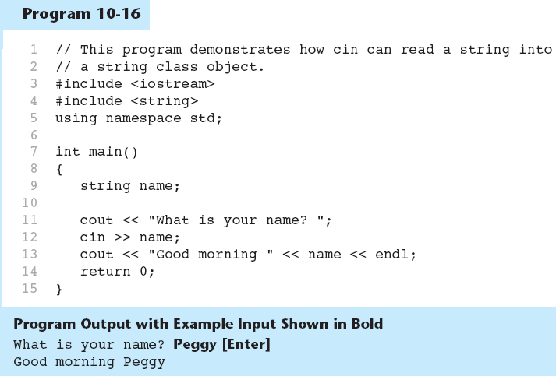
String Input - example

Slide 56
String input: cin
When the input stream cin is used, white-space character (space, tab, newline etc. ) are used
  Separators – read next data
  Terminators - terminates reading a value

Slide 57
String input: getline()
Use getline() to read a line of input (with spaces) into a string object
The getline() reads from the current position in the input stream until a newline character is found.
The getline() that takes 2 parameters:
    1st specifies an input stream eg. cin or file name
    2nd specifies a string variable.
Example: getline(cin,name);

Slide 58
String input: getline()
The getline() with 3 parameters:
  1st & 2nd as the getline() with 2 parameters.
  3rd specifies the terminator character i.e. the character at which getline() will stop reading from the input stream.
Example:
    iFile.open(“String1.dat”);
    getline(iFile,name, ‘\t’);

Slide 59
Exercise Week06_04
Change Program 10-13 to use getline() statements in order to read name from keyboard & file

Slide 60
string operator
string s3, s4;
string s1(“Salam");
string s2(“ Dad");
s3 = s1 + s2; //Concatenation
s4 = “Hello Mom!” //Assignment

Slide 61
Overloaded string Operators
OPERATOR | MEANING
>> | reads whitespace-delimited strings into string object
<< | outputs string object to a stream
= | assigns string on right to string object on left
+= | appends string on right to end of contents of string on left

Slide 62
Overloaded string Operators (continued)
OPERATOR | MEANING
+ | concatenates two strings
[] | references character in string using array notation
>, >=, <, <=, ==, != | relational operators for string comparison. Return true or false

Slide 63
Overloaded string Operators
string word1, phrase;
string word2 = " Dog";
cin >> word1; // user enters "Hot"
// word1 has "Hot"
phrase = word1 + word2; // phrase has
// "Hot Dog"
phrase += " on a bun";
for (int i = 0; i < 16; i++)
cout << phrase[i];
// displays "Hot Dog on a bun"

Slide 64
string Member Functions
Are behind many overloaded operators
Categories:
  assignment: assign, copy, data
  modification: append, clear, erase, insert, replace, swap
  space management: capacity, empty, length, resize, size
  substrings: find, substr
  comparison: compare
See Table 10-7 for a list of functions

Slide 65
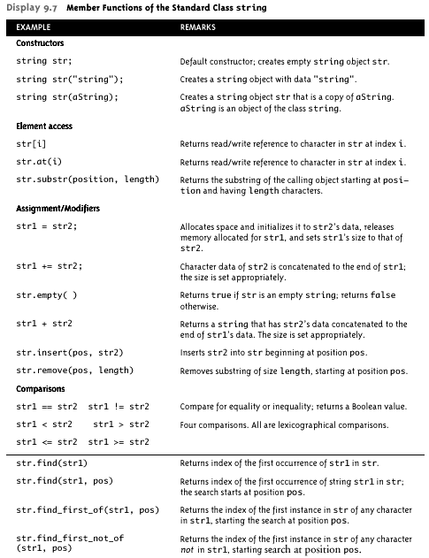

Slide 66
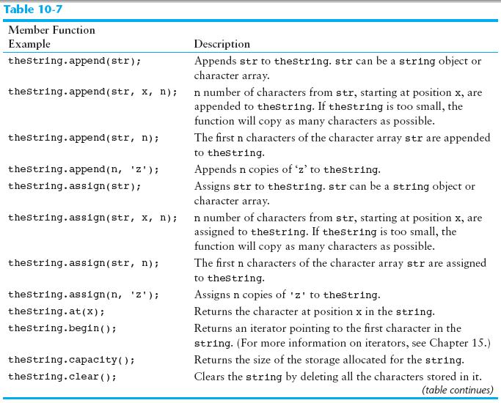

Slide 67
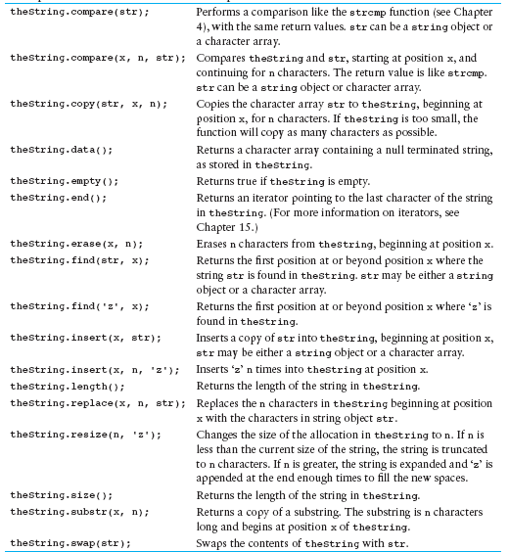

Slide 68
Length of a String
The number of characters it contains, including whitespace characters, if any.
Example:
  string s1 =“Radziah Mohamad”;
  int sLength= s1.length();
  // will give 15

Slide 69
Modification of string objects
→ appends contents of s to end of str
  string str =“Abang ”;
  string s = “Ismael”;
  str.append(s);
inserts s3 at position pos in str
string s3('*‘, 3);
str.insert(5, s3)

Slide 70
Substrings
substr method returns a substring;
syntax is:
s.substr(position, length)
Caution: substrings
Example:
  string name = "object";
  string sub = name.substr(2,3);
  // sub is "jec"
  sub = name.substr(3,15); // not error!
  // sub is "ect"

Slide 71
Exercise Week04_07
Do Lab 6, Exercise 2, Question 1 (pg. 94)
Do Lab 6, Exercise 2, Question 2 (pg. 95)

Slide 72
Conversion to C-strings
data() and c_str() both return the C-string equivalent of a string object
Useful when using a string object with a function that is expecting a C-string
char greeting[20] = "Have a ";
string str("nice day");
strcat(greeting, str.data());

Slide 73
Exercise Week04_08
Do Lab 6, Exercise 3, Question 6 (pg. 98)
Do Lab 6, Exercise 3, Question 7 (pg. 98)

Slide 74

Thank You
Q & A

